Slide 1


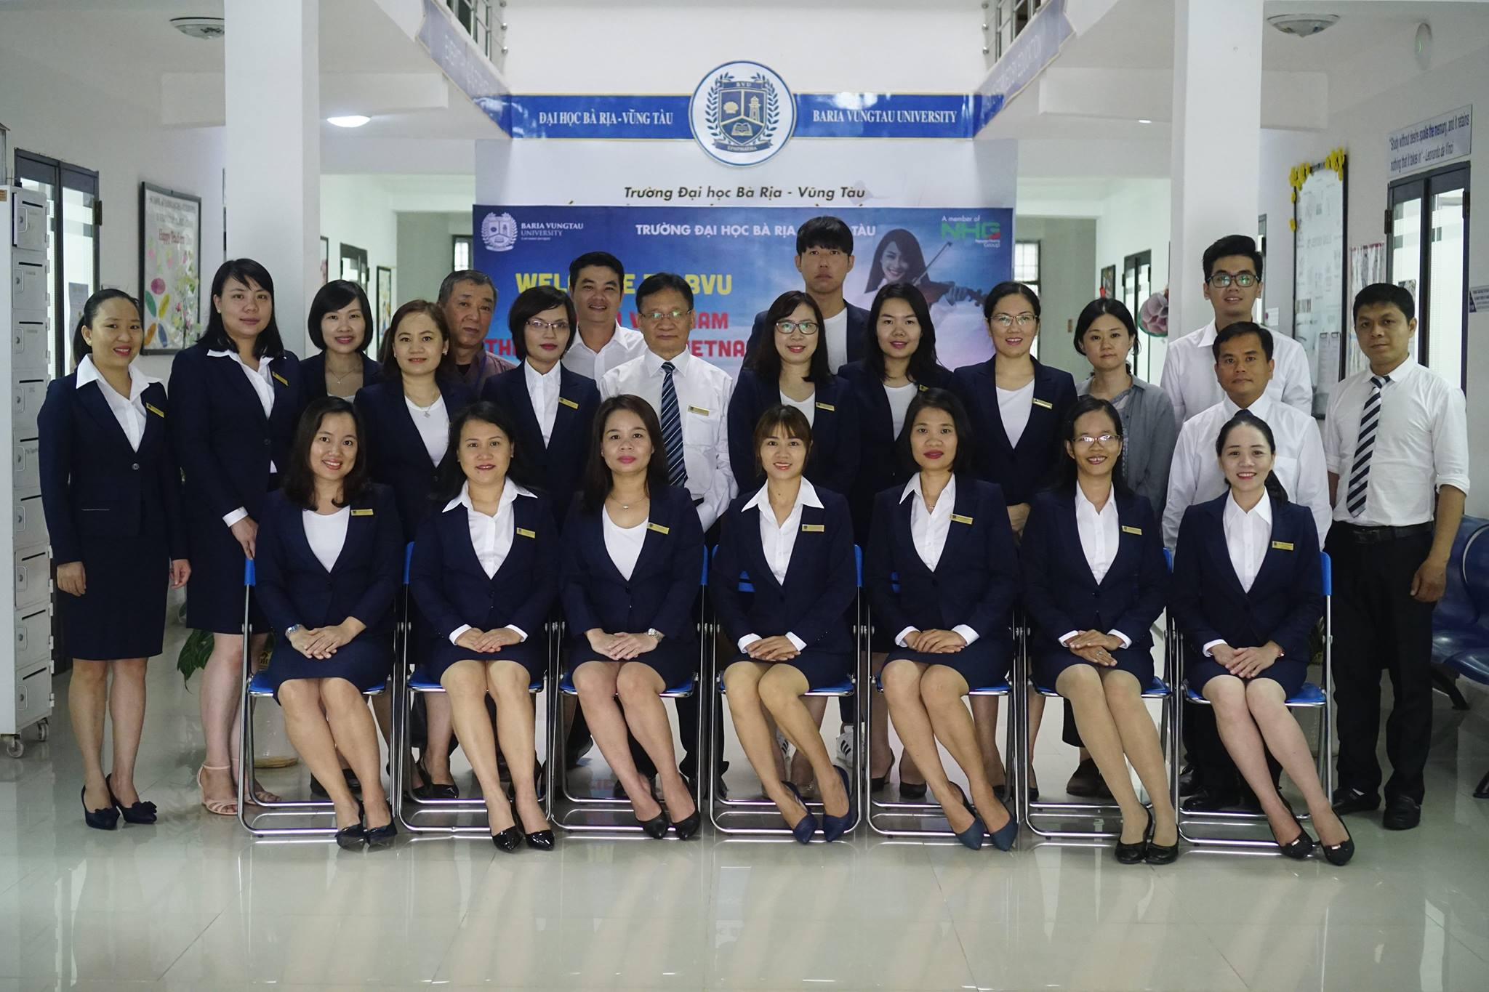

Slide 2
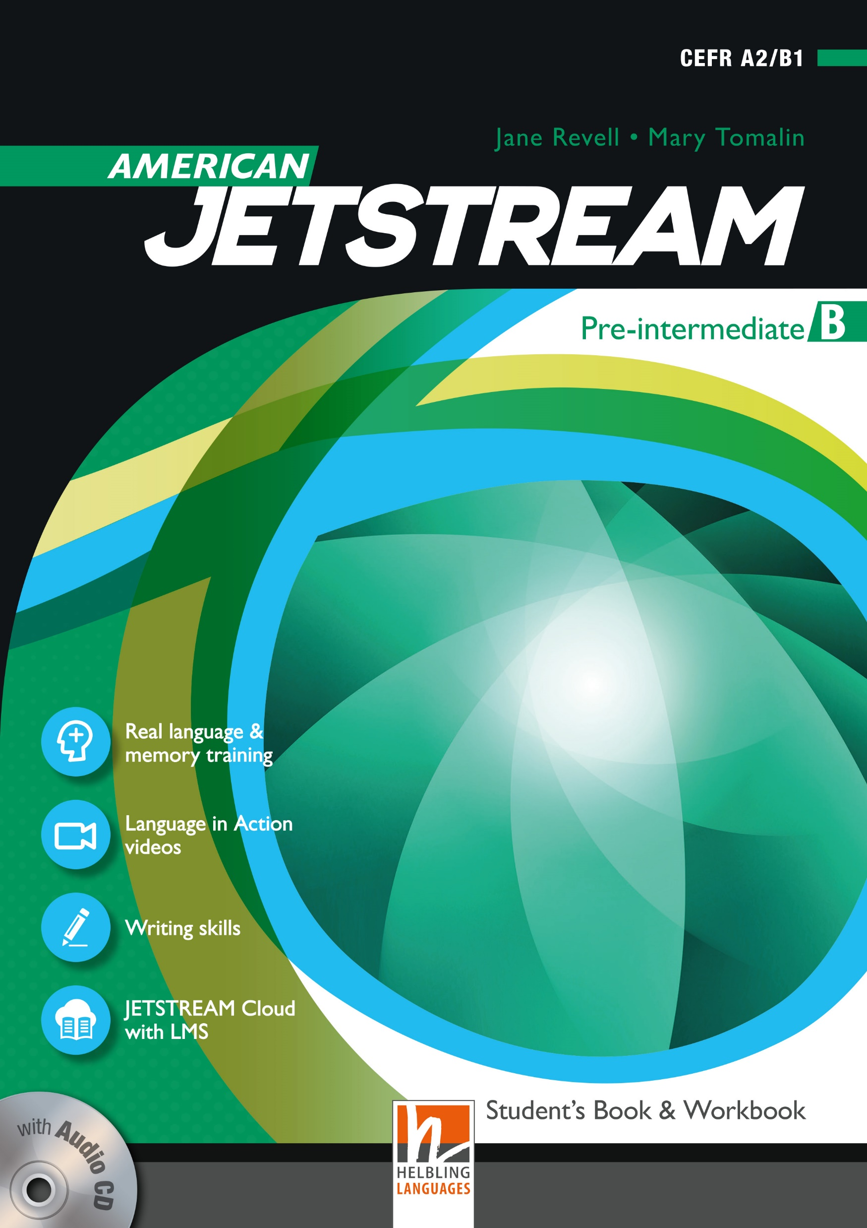
AMERICAN JETSTREAM PRE-INTERMEDIATE B

Slide 3
TEACHER’S PERSONAL INFORMATION
Name: Nguyen Thanh Loan
Facebook: Loan Nguyễn Thanh
Mobile number: 0942 255 937
Email: loannguyenthanh1978@gmail.com

Slide 4
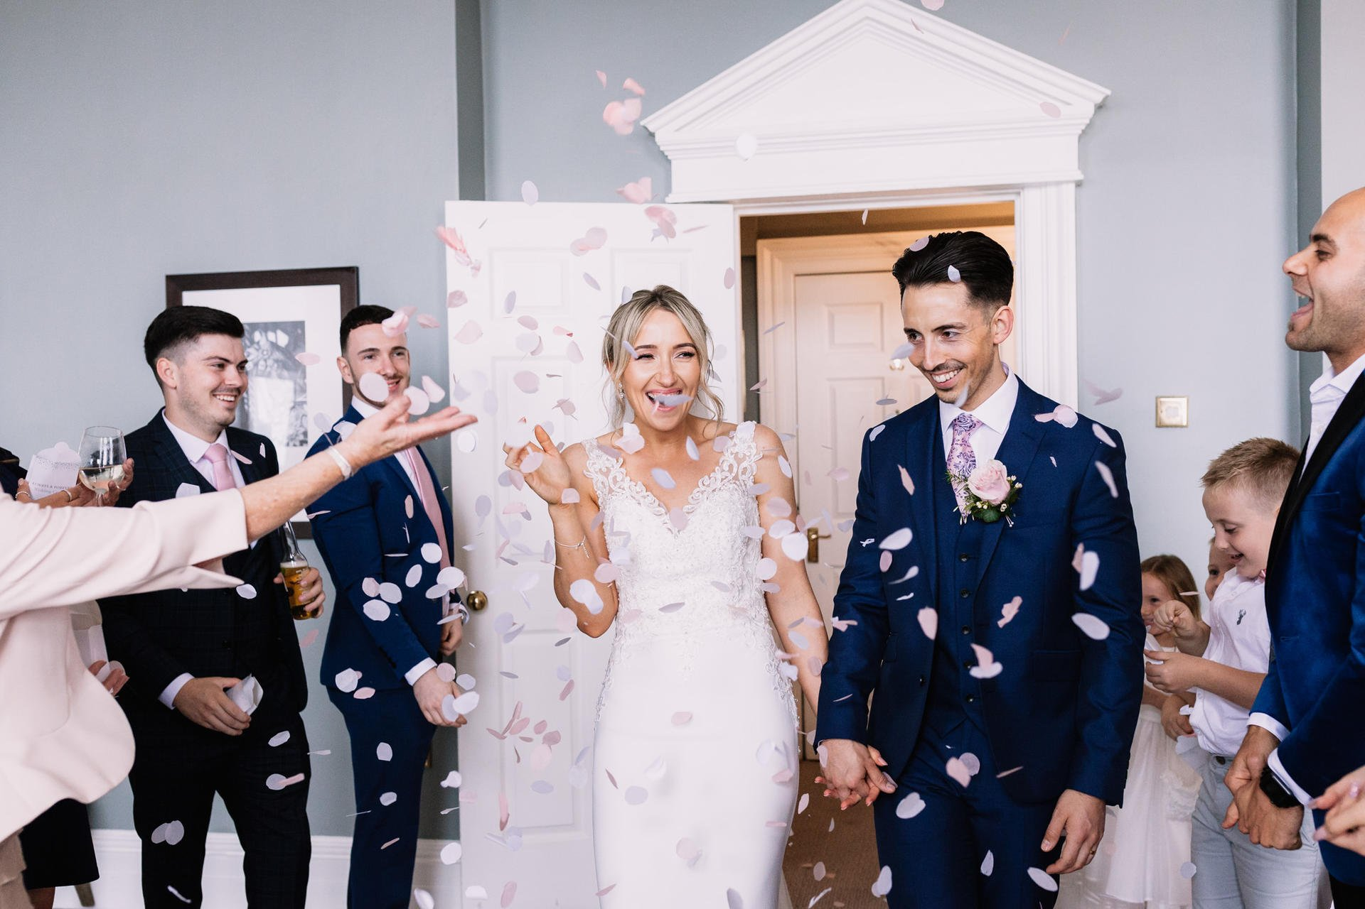
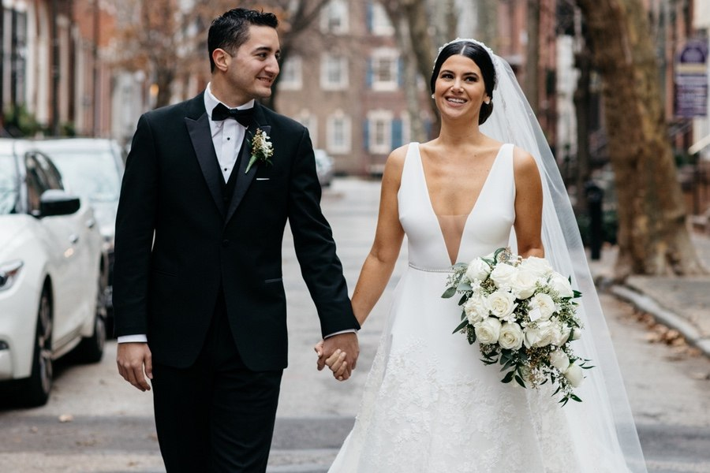
UNIT 12
SPECIAL OCCASIONS
/ˈspeʃl əˈkeɪʒn/
a particular time when something happens

Slide 5
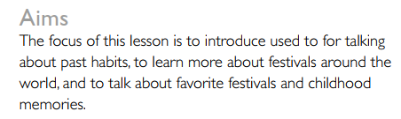
UNIT 12
SPECIAL OCCASIONS
Lesson 2
Celebrations, past and present

Slide 6
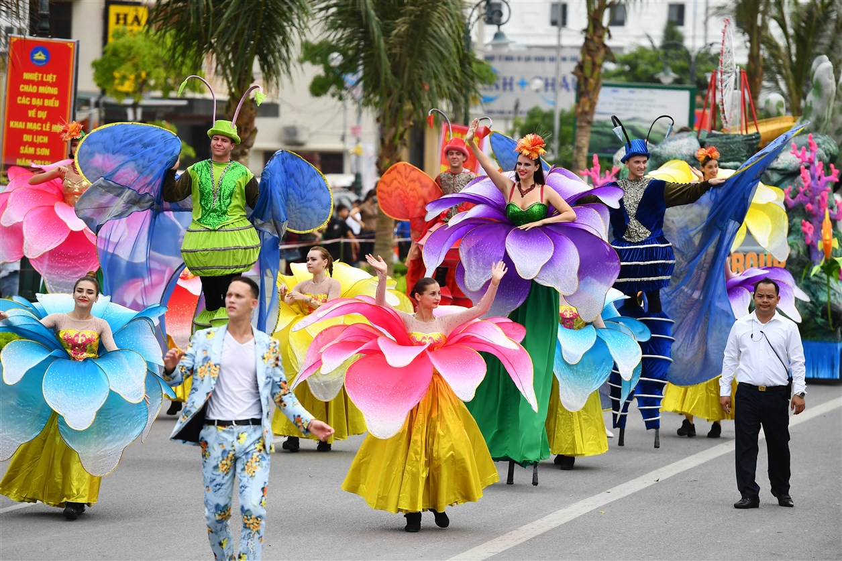
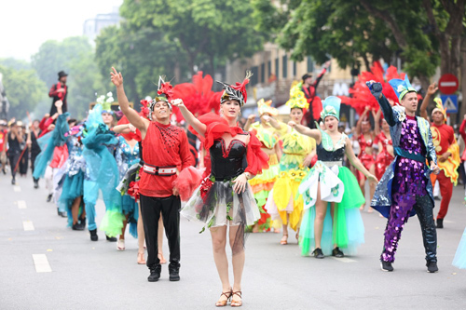
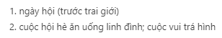
VOCABULARY
Celebrations
Carnival
a public festival, usually one that happens at a regular time each year, that involves music and dancing in the streets, for which people wear brightly coloured clothes
/ˈkɑːnɪvl/

Slide 7
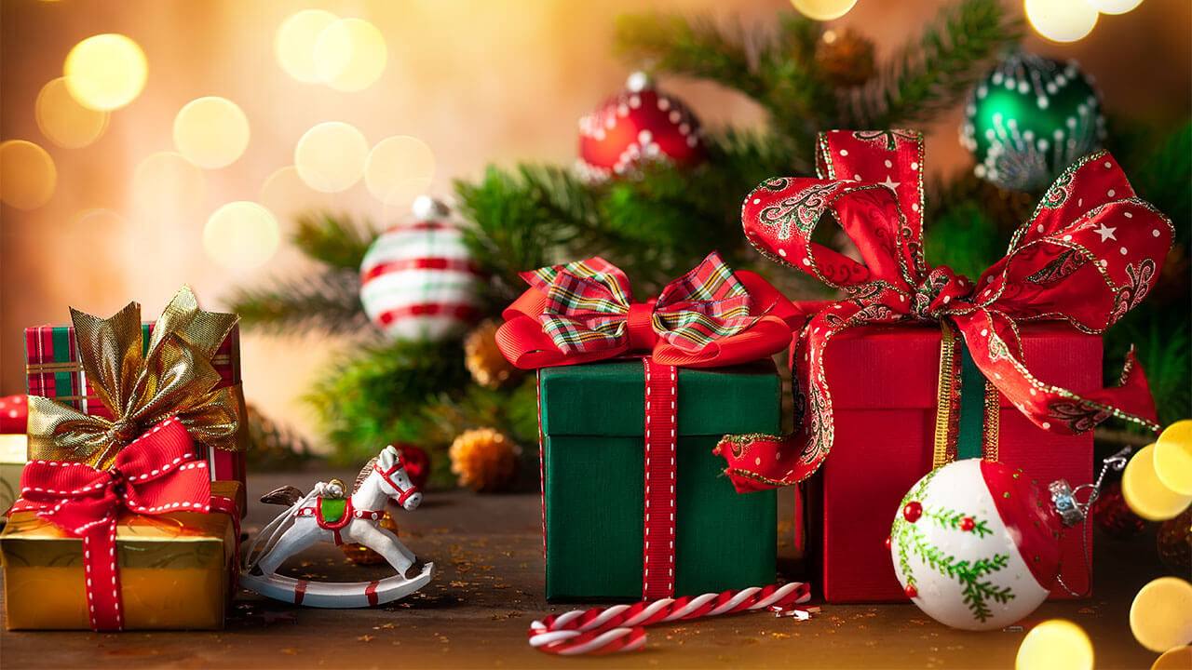
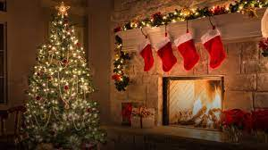
VOCABULARY
Celebrations
Christmas
25 December, the day when Christians celebrate the birth of Christ
/ˈkrɪsməs/

Slide 8
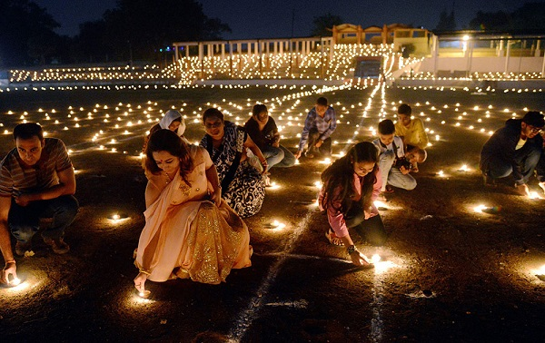
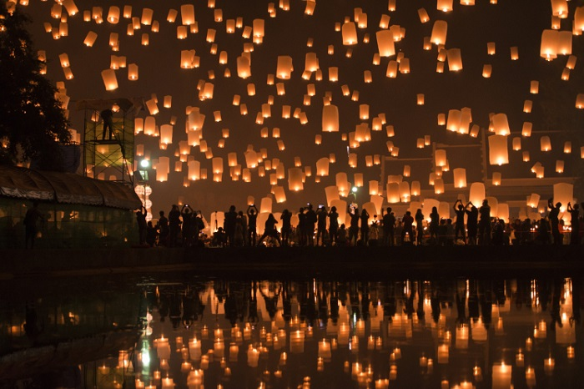
VOCABULARY
Celebrations
Diwali
a Hindu festival that is held in the autumn, celebrated by lighting candles and clay lamps, and with fireworks
/dɪˈwɑːli//

Slide 9
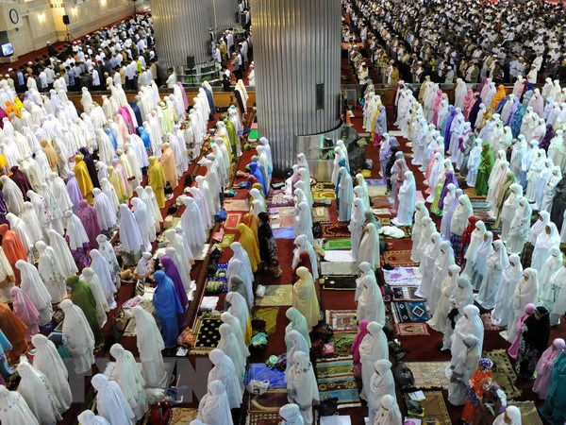
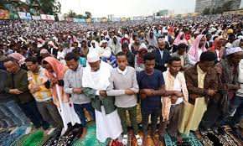
VOCABULARY
Celebrations
Eid
one of the two main Muslim festivals, either Eid ul-Fitr /iːd ʌl fɪtə(r)/ at the end of Ramadan, or Eid ul-Adha /iːd ʌl ʌdə/, which celebrates the end of the pilgrimage to Mecca
/iːd/
một trong hai lễ hội chính của người Hồi giáo

Slide 10
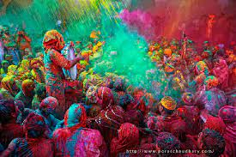
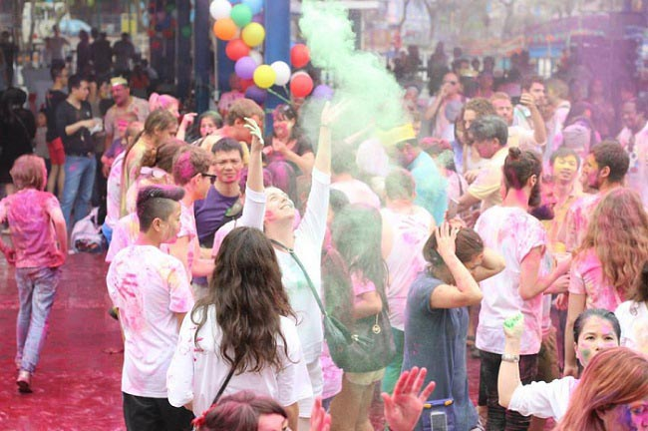
VOCABULARY
Celebrations
Holi
is a popular ancient Hindu festival. The festival signifies the triumph of good over evil
là một lễ hội Hindu cổ đại phổ biến. Lễ hội biểu thị sự chiến thắng của cái thiện trước cái ác

Slide 11
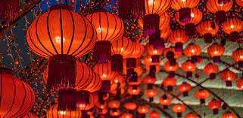
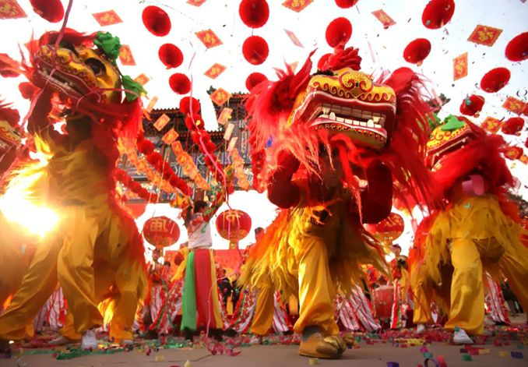
VOCABULARY
Celebrations
Spring festival
another name for Chinese New Year.

Slide 12
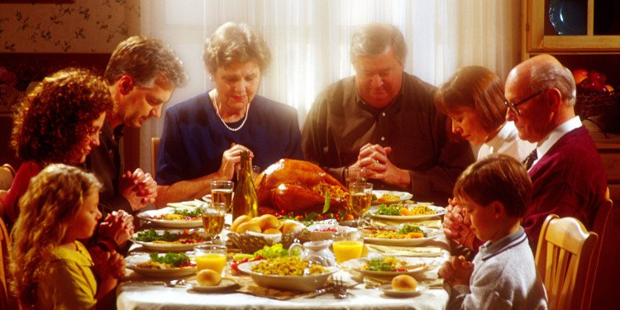
VOCABULARY
Celebrations
Thanksgiving
a public holiday in the US (on the fourth Thursday in November) and in Canada (on the second Monday in October), originally to give thanks to God for the harvest and for health
/ˌθæŋksˈɡɪvɪŋ/

Slide 13
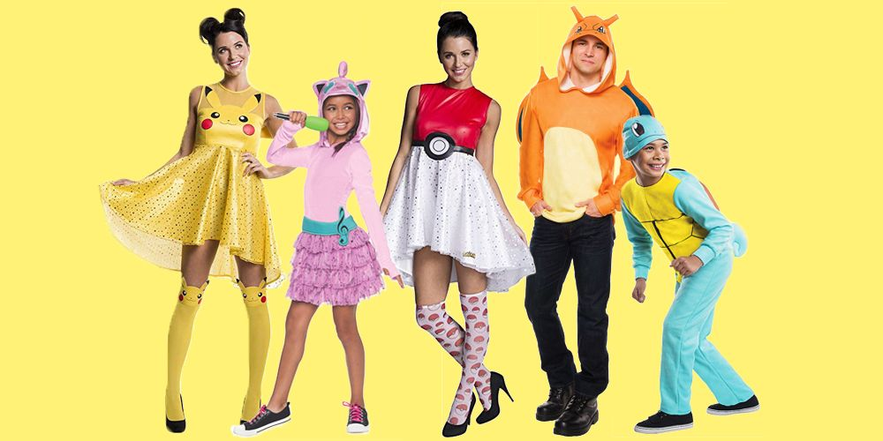
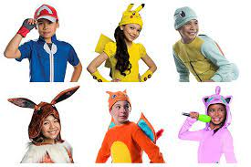
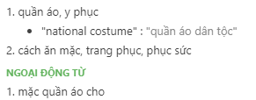
VOCABULARY
Celebrations
costume
/ˈkɒstjuːm//
the clothes worn by people from a particular place or during a particular historical period

Slide 14
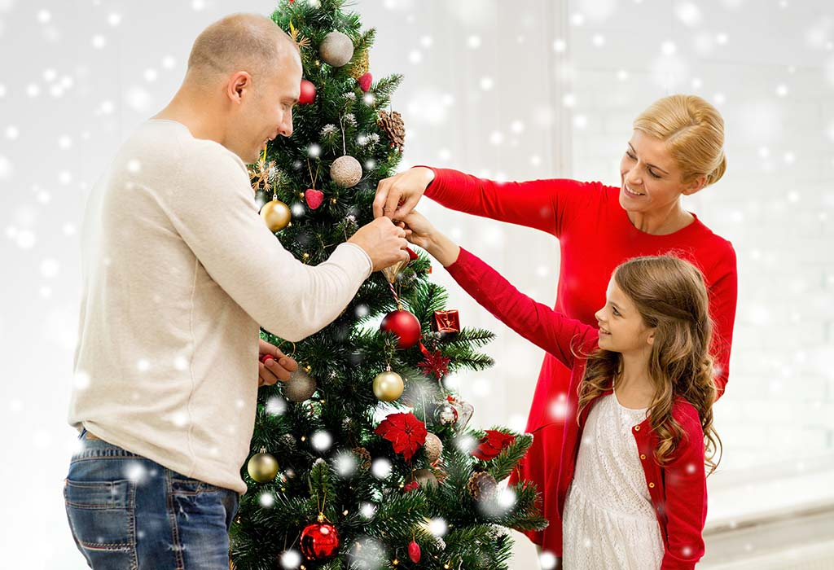
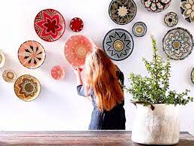
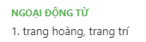
VOCABULARY
Celebrations
decorate
/ˈdekəreɪt//
to make something look more attractive by putting things on it

Slide 15
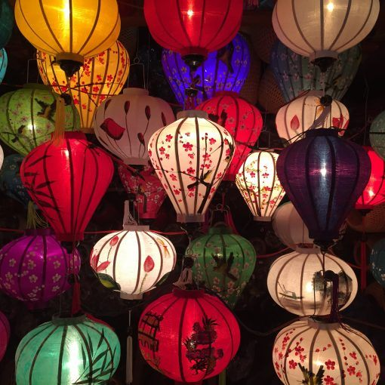
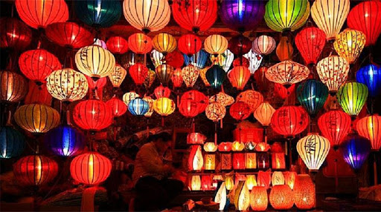
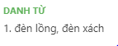
Celebrations
VOCABULARY
lantern
/ˈlæntən/
a lamp in a clear case, often a metal case with glass sides, and often with a handle, so that you can carry it outside

Slide 16
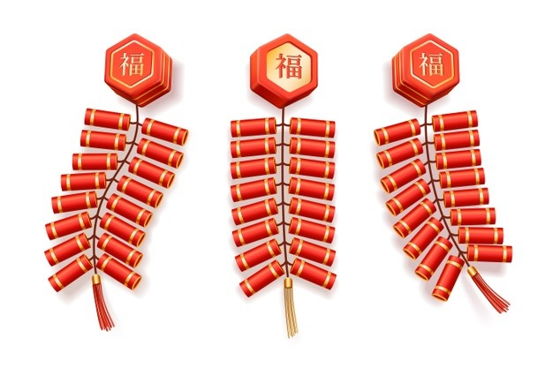

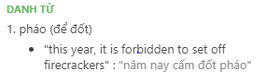
VOCABULARY
Celebrations
firecracker
/ˈfaɪəkrækə(r)/
a small firework that explodes with a loud noise

Slide 17
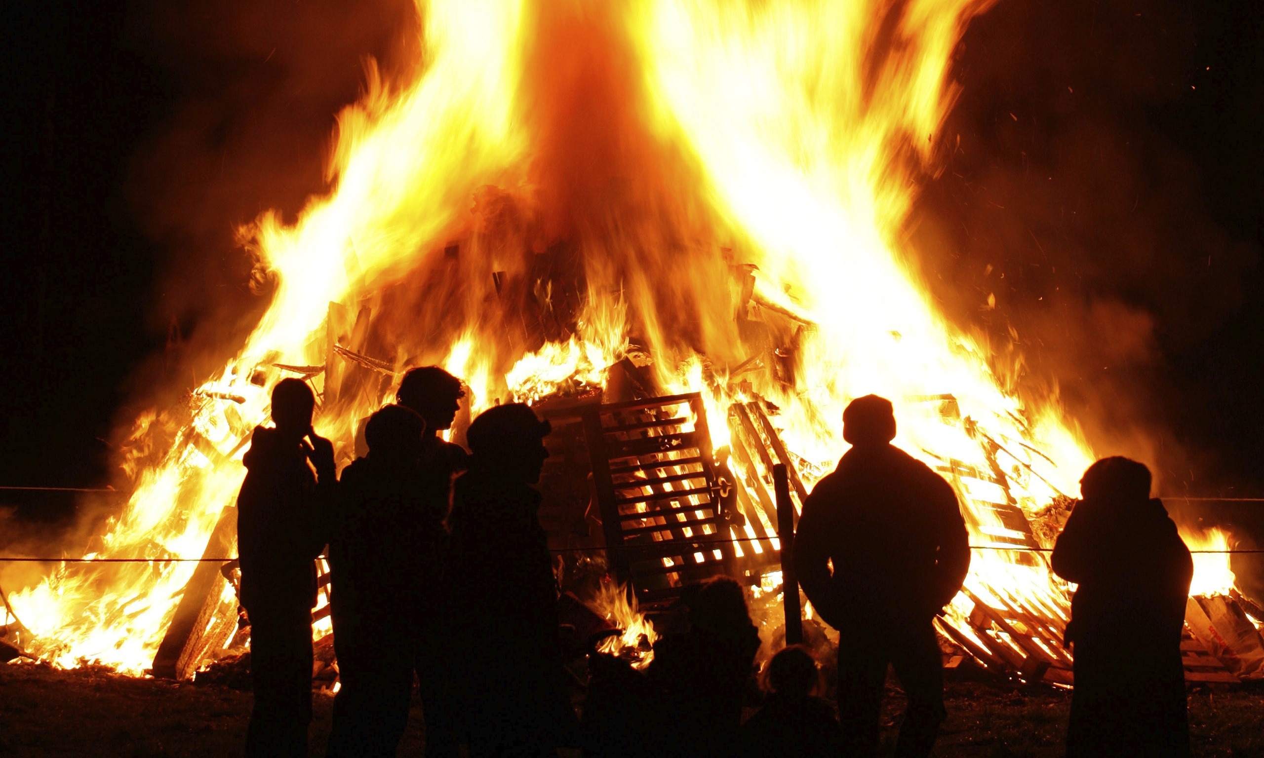
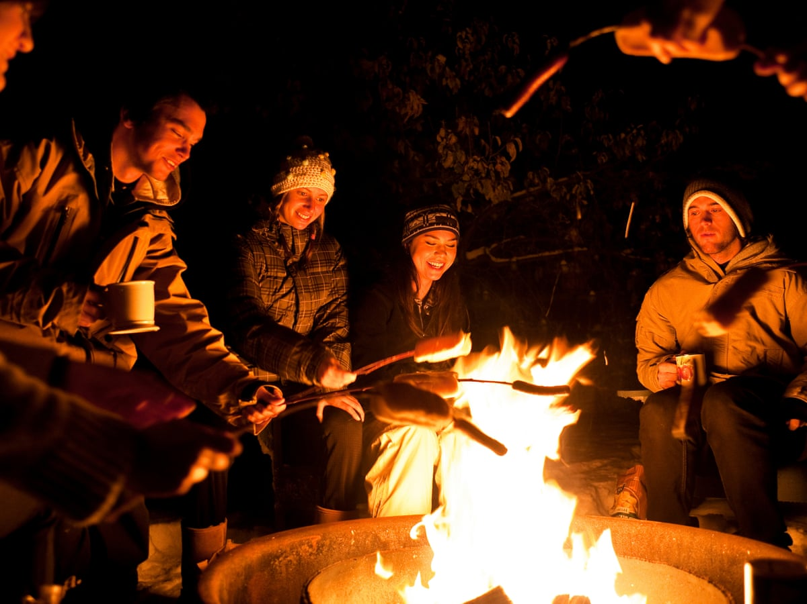
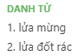
Celebrations
VOCABULARY
bonfire
/ˈbɒnfaɪə(r)/
a large outdoor fire for burning waste or as part of a celebration

Slide 18


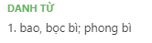
VOCABULARY
Celebrations
envelope
a flat paper container used for sending letters in, with a part that you stick down to close it
/ˈenvələʊp/

Slide 19
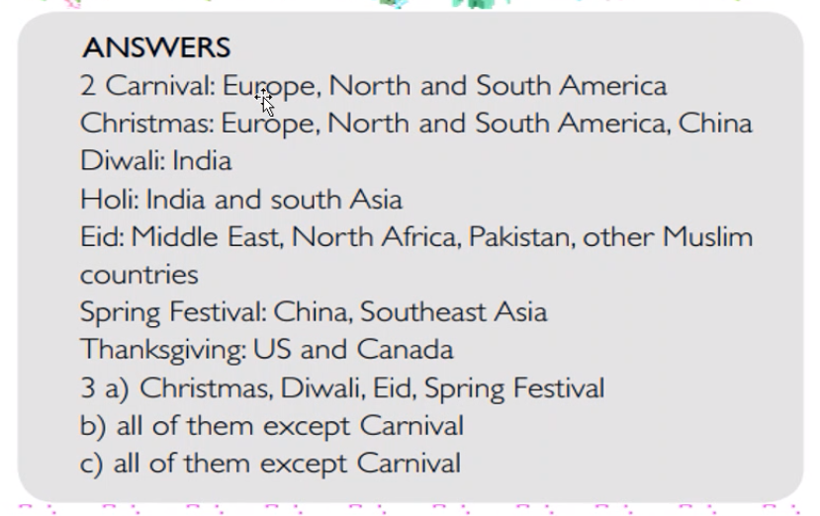

Slide 20
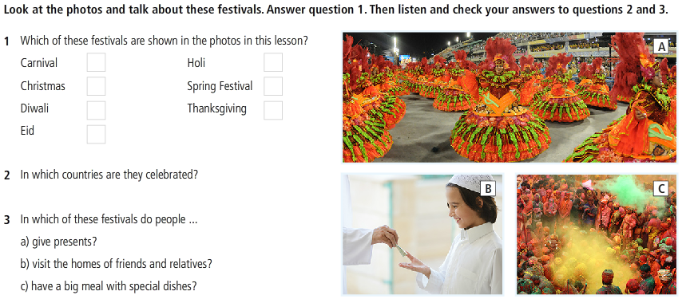

SPEAKING AND LISTENING

Slide 21
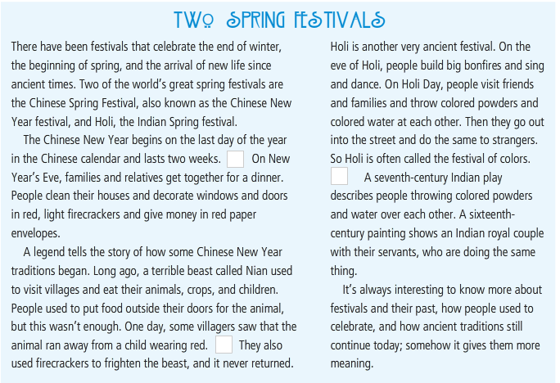
READING

Slide 22
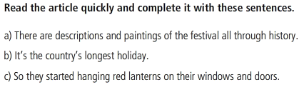
READING

Slide 23
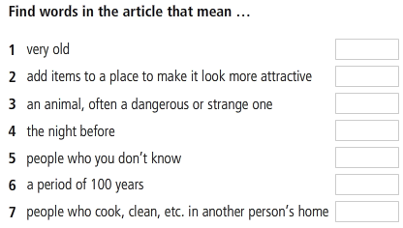
READING

Slide 24
SPEAKING
1. On what occasions do you give people presents?
2. What kind of present do you give?

Slide 25
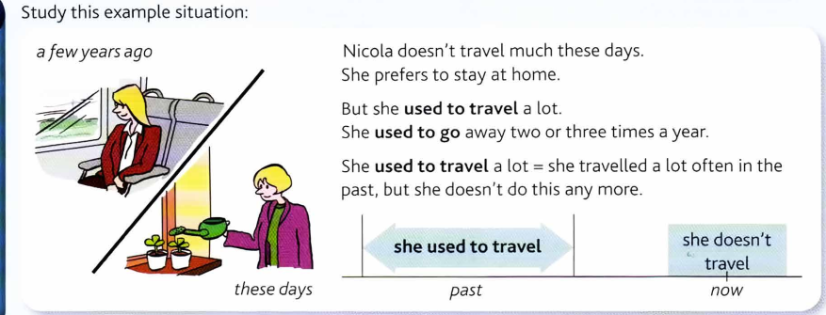
GRAMMAR
Used to

Slide 26
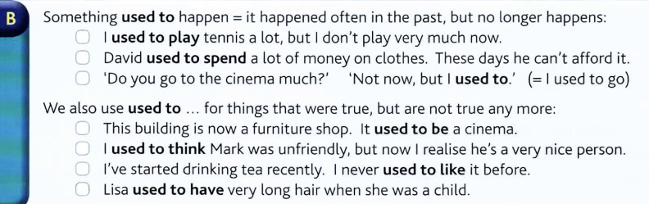
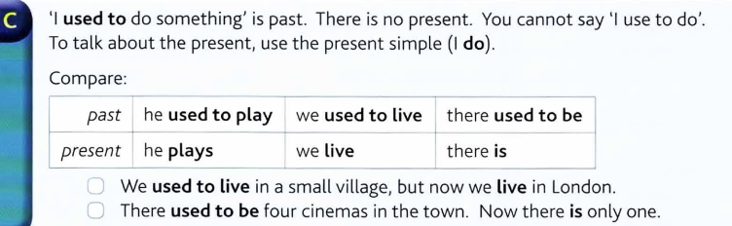
GRAMMAR
Used to

Slide 27
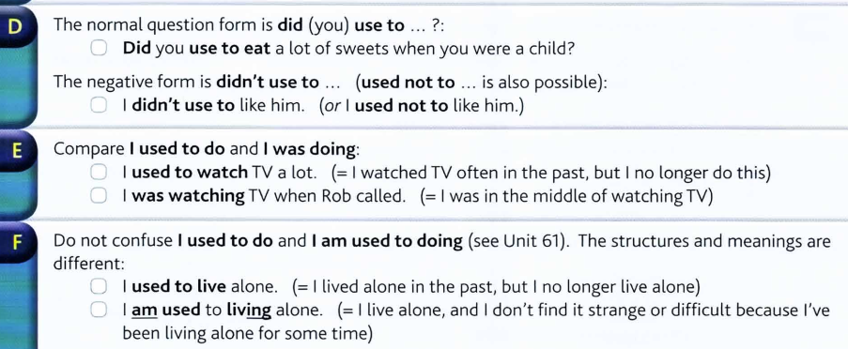
GRAMMAR
Used to

Slide 28
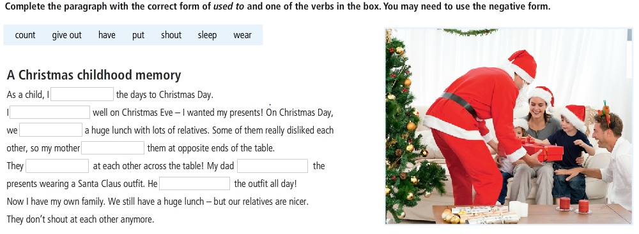
GRAMMAR
Used to

Slide 29
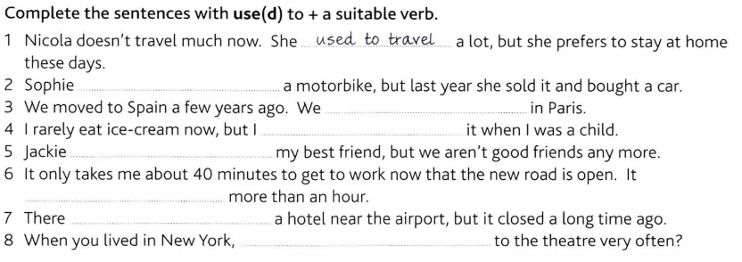
GRAMMAR
Used to

Slide 30
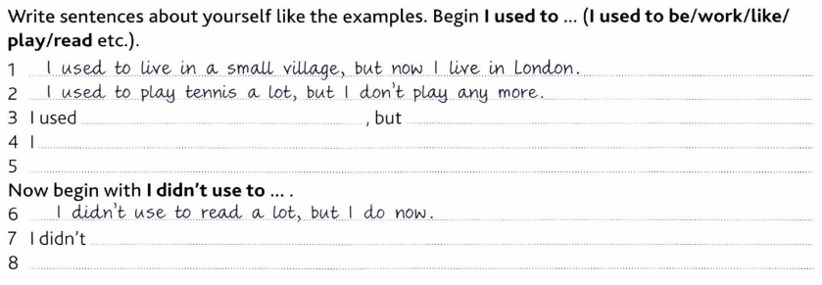
GRAMMAR
Used to

Slide 31
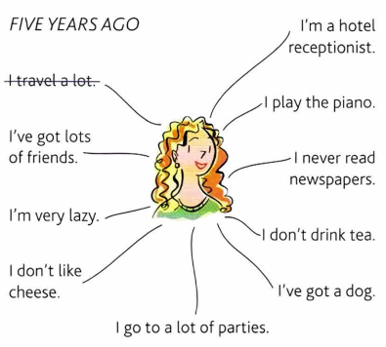
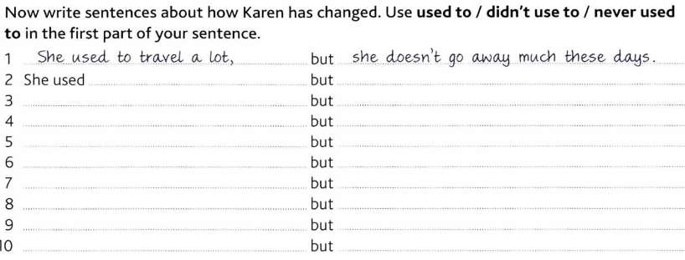
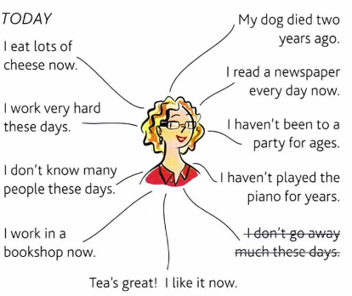

Slide 33
REFERENCES
Vocabulary: Holidays and special events
https://www.youtube.com/watch?v=0a15UOja3JM
https://www.youtube.com/watch?v=qzomIsP99wA
Grammar: used to
https://www.youtube.com/watch?v=EvjdYDhyfv4
Listening and watching the video
https://www.youtube.com/watch?v=yhGQchXSkKY
https://www.youtube.com/watch?v=YvcTZ_hNSPU

